Slide 1
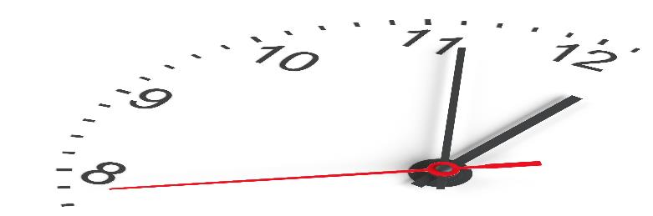
Negotiated Workplace Learning Week 5
Time Management
Sandra Okwara

Slide 2
Aims
Importance of effective management
Analysis of time spending
Tools and techniques for time management
Prioritising work
Benefits of prioritising work

Slide 3

Time Management
Do you ever feel like there's not enough time in the day?
Everyone gets 24 hours
Some people achieve more than others
Those who achieve more manage their time better than others
Time management is the process of organizing and planning how to divide time between different activities. This helps individuals to reduce the working hard syndrome and adopt the working smarter strategy to achieve more activities in less time including when pressures are high and time is tight

Slide 4
Importance of Effective Time Management in the workplace
Time needs to be managed well to avoid work overload and stress/strain at work and in working relationship as well as relationships outside of work. Good time management in the workplace supports with :
Removing non essential activities
Achieving more work by being more productive
Enhancement of career development
Meeting the required deadlines for tasks
Having a good work life balance

Slide 5
Importance of Effective Time Management on a personal level
Helps individuals to be more organised
Take control of projects
Create objectives for short, medium and long term success
Increases productivity by being more efficient
Decrease in stress and anxiety thereby having a better health and well being

Slide 6

Causes of poor time management at work
Lack of or poor communication – 18%
Lack of management planning 30%
Poor management planning (30%)
Inappropriate/Inadequate Supervision 30%
Problems with Information technology with low morale and lack or inaccurate matching of skills – 21%

Slide 7
Analysis of time management
To improve our time management, we need to first analyse how we spend our time
Use of planners to identify activities at work
Analyse the activities and review how time is spent
Identify productive and unproductive activities

Slide 8
Areas of work to consider
Coffee and tea break
Important for reducing stress
Creates opportunity for human contact
Helps to avoid sitting and spending time in one position
Impact assessment and review of the breaks is important
Informal breaks can cause time wasting
Can cause advice seeking from the wrong individuals
Can increase/ decrease confidence in individual’s decision making

Slide 9

Meetings in the work place
Can be excessive and run for a long time
Is it an efficient use of everybody's time
Can points be covered in one meeting rather than several meetings?
Is everyone required to be din the meeting?
Can we use a different means of communication to convey the message?
Are the meetings needed or are the habitual meetings?

Slide 10
Allocation of workload and insufficient communication
Delegation of tasks in the workplace is important and if not well managed, individuals can spend excessive time on task not allocated to them.
Allocated workload must be communicated to individuals and team members.
Work allocated to individuals need to be reviewed
Communications about delegated work should be effective and efficient

Slide 11

Discussion Activity
Reflect on your work and identify the activities that distract you from your work
How can you address these factors without having a negative impact on your work relationships with others
Identify the areas that you have used your time well at work
How can you use the identified positive areas to strengthen other parts of your job

Slide 12
Tools and Techniques for Time management
Use of Smart objectives
Prioritise task to achieve team and organisational goals
Have personal objectives which align with the team goals
Breakdown of task into manageable and measurable stages
Make us of logs to identify time spent . This helps to identify what we are really doing as opposed to what we think we are doing daily.
Assess daily activities with the use of Pareto Principle known as the 80-20 rule

Slide 13
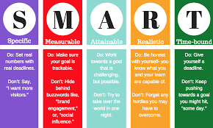
Smart Objectives

Slide 14
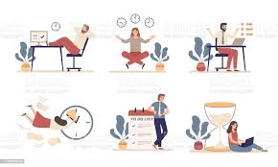
Planning the activities at work
Use a planner to plan and schedule activities for the day
Have a quick check of the activities to ensure they are important on the list
Identify the activities and when they need to
Complete one job at a time
Avoid picking up new jobs as reasonably practicable
Plan task in order of priority
Include time for interruptions
Be assertive and say no when needed

Slide 15
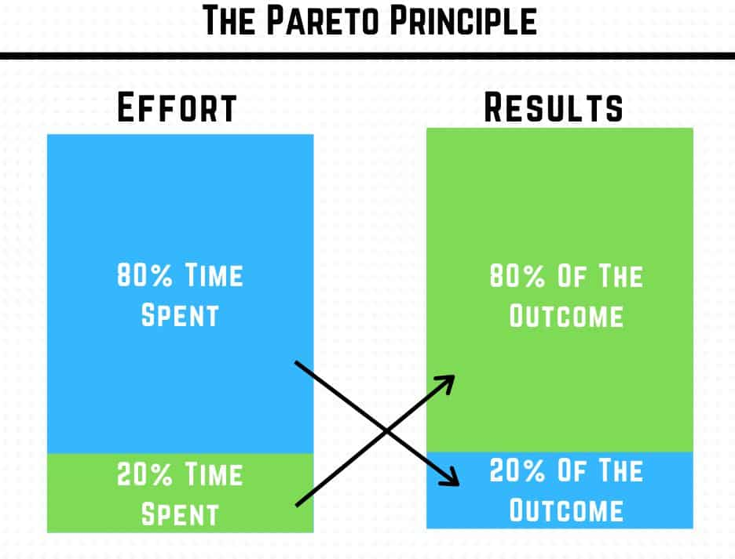
Pareto Principle (80-20 rule )
Useful in assessing efforts and activities to identify which activities are most effective
https://www.youtube.com/watch?v=DprO3TcrlpY
80% of output is produced from 20% of input
80% of results come from 20% of effort
80% of profit comes from 20% of the product
In review of time spent, identify where your 20% productivity is which produces the 80% of the output. This helps to improve general output and efficiency.

Slide 16
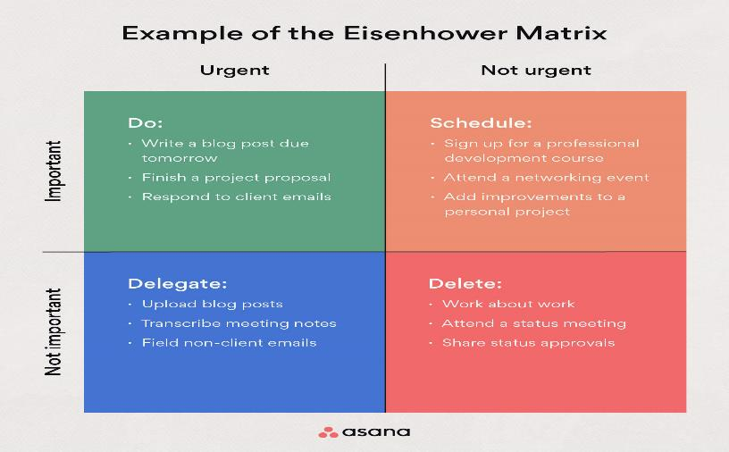
Review and Analyse priorities

Slide 17
Benefits of prioritising work
Time is used more efficiently
Communication is improved
Service users are served better
Less complaints will be received
More conducive work environment
Improved mental health and physical well being
Time created for unexpected activities

Slide 18
Review learning ?
What have we learnt
What techniques and tools would you use to manage your time?
What changes will you make from now?

Slide 19
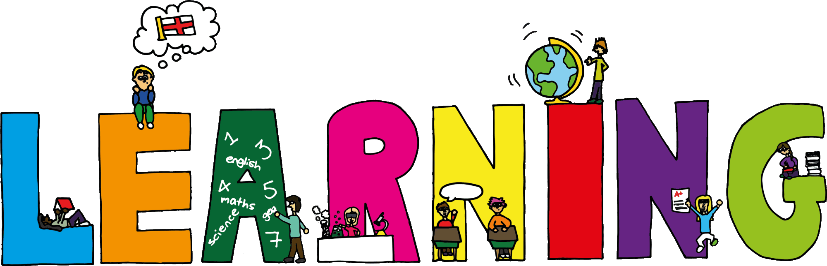
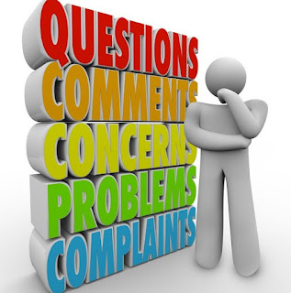
What have you Learnt?

